Slide 1


Breaking News: Psycholinguistic and Behavioural Differences in (Un)-Trustworthy Online News Source Interaction
May 9th 2023
Pietro Aluffi, Léo Meyent, Clemens Stachl

Slide 2
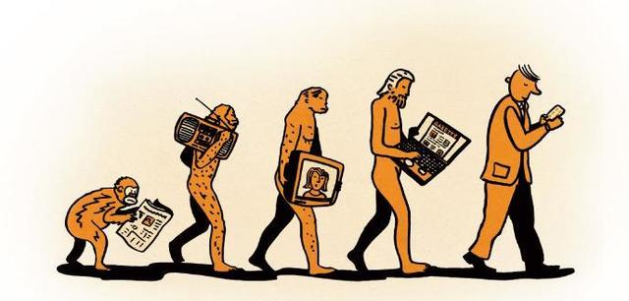
Notes:
Throughout times humans always had the need to reshare information (gossip). We have this need that sometime hinders our ability to filter content.
From consumer to shares. At the beginning sources were concentrated.
Furthermore, the impact of resharing information online has been increasing with the advent of online activities and due to the human tendency and psychological need to share information, exacerbated by online social networks (Karahanna et al., 2018).
If this person with the mobile in the hand is a mis sharers, how would we know?

Slide 3
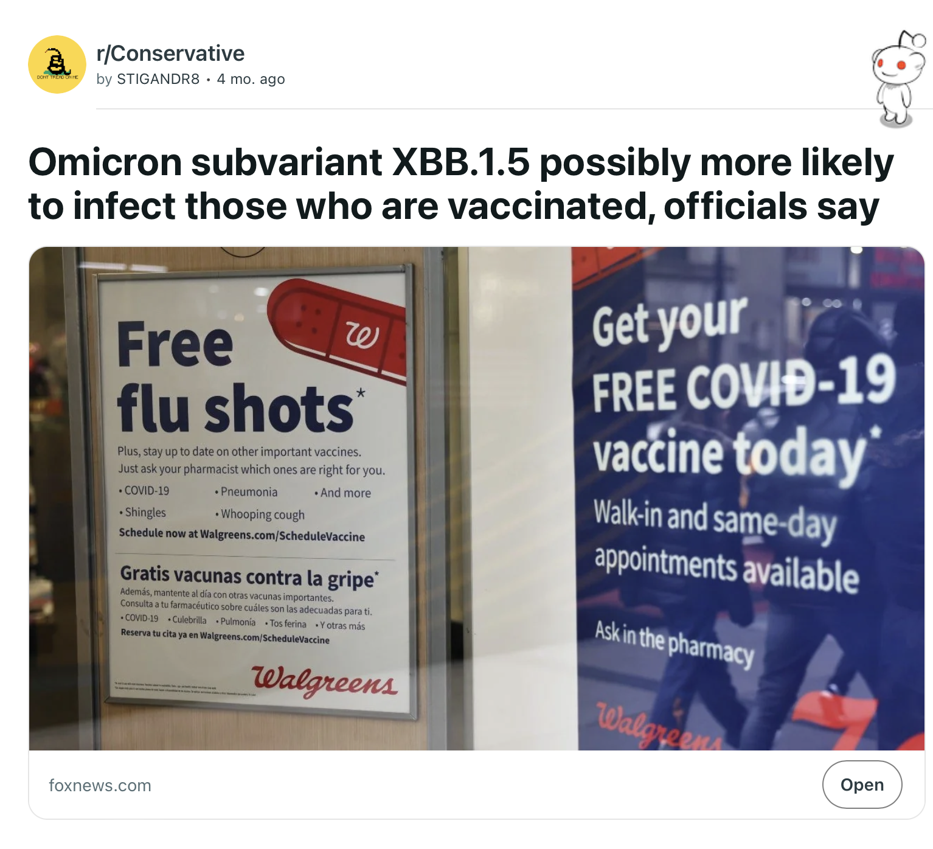
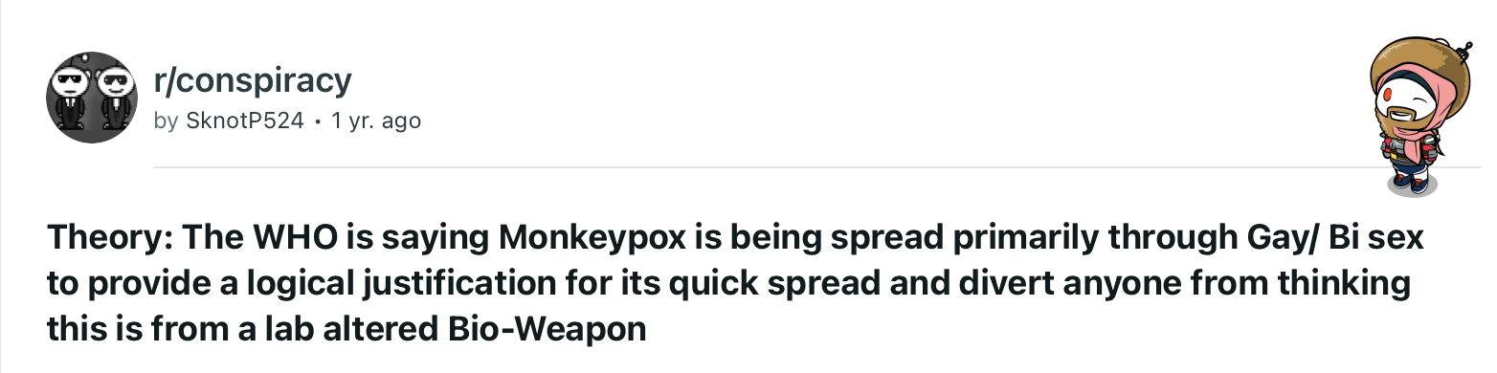
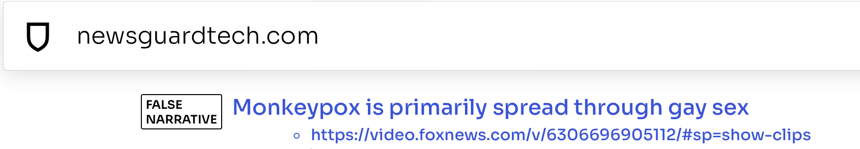
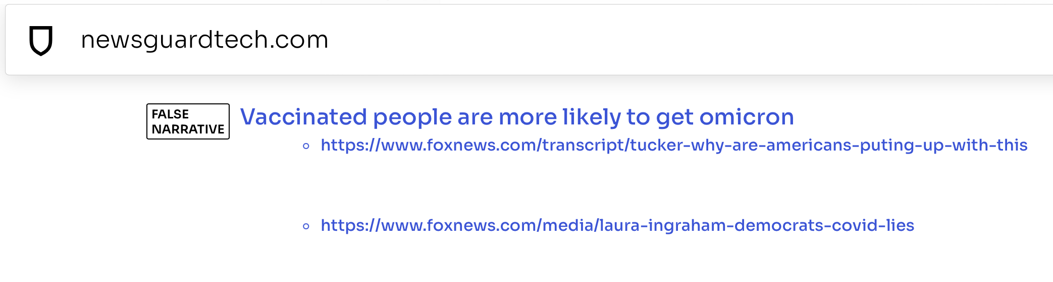
Notes:
Throughout times humans always had the need to reshare information (gossip). We have this need that sometime hinders our ability to filter content.
From consumer to shares. At the beginning sources were concentrated.
Furthermore, the impact of resharing information online has been increasing with the advent of online activities and due to the human tendency and psychological need to share information, exacerbated by online social networks (Karahanna et al., 2018).
If this person with the mobile in the hand is a mis sharers, how would we know?

Slide 4
Characterizing and predicting misinformation sharers I/II
Predicted user misinformation sharing likelihood with demographics, personality, emotion, writing style, and social media behavior. Shrestha & Spezzano, 2022
Used LIWC features to detect characteristics of Twitter users sharing misinformation. Shrestha & Spezzano, 2020
Evaluated ML models for predicting user reposting from unreliable sources using linguistic and topic features. Mu & Aletras, 2020
Notes:
Predicted the likelihood of a user being misinformation sharers with demographics, personality, emotion, writing style and social media behavior features. Shrestha & Spezzano, 2022
Used LIWC features to detect characteristics of twitter users keen at sharing misinformation and showed that are important characteristics to consider when modeling user sharing behavior Shrestha & Spezzano, 2020
ML models evaluation on predicting whether a user will repost content from unreliable sources using psycholinguistic, bag of words and topic features. Mu & Aletras, 2020

Slide 5




Previous research
Our approach
Twitter
Reddit
1-period analysis
Time-series detection
Notes:
existing work has found that feature in slide 3 are predictive of sharing misinf. What however is missing is the temporal component that I add. My model, for instance, has a 12-month. prediction period.
This is important because it would allow us to detect and potentially prevent that misinfo becomes viral.
However:
results from previous work specifically focus on Twitter users. We test whether these findings are transferable to Reddit data;
results from previous research do not include a temporal component. We propose a forward-looking approach which allows detection and prevention of misinformation sharing.

Slide 6
RQ1: Which psycholinguistic characteristics are predictors of users’ probability of sharing (un)trustworthy news sources?
RQ2: How does variation of psycholinguistic characteristic predict future sharing behaviour of (un)trustworthy news sources?
Notes:
RQ1: What are systematic differences in users’ psycholinguistic characteristic regarding interaction with (un)trustworthy news sources?
RQ2: To what extended is the variation over time of psycholinguistic characteristic predictive of future interaction with (un)trustworthy news sources?
To answer the RQs we introduce the following contribution
predictor of future untrustworthy news diffusion

Slide 7





Characterization and early prediction of misinformation sharers
Novel dataset
Psycholinguist Characterization
Early warning detection
Notes:
Introduce a novel dataset that combines reddit data with labels
Identify most impactful psycholinguistic characteristics

Slide 8
Methodology

Slide 9
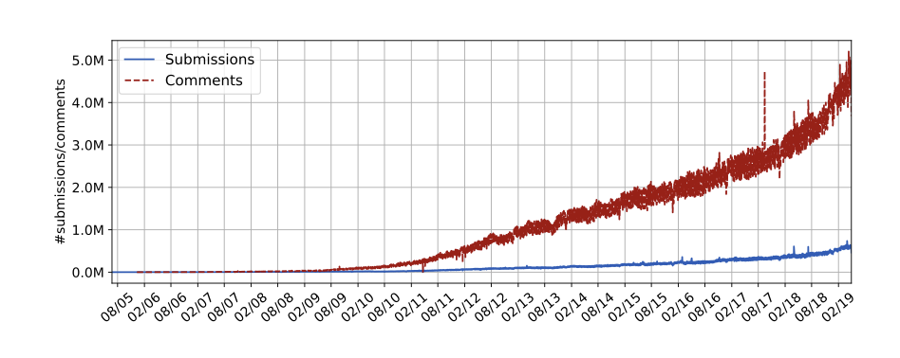
Datasets
Reddit Pushshift Dataset
Timeline: 2014-2021
Submissions across all subreddits ~ 500GB
Comments across all submissions ~1.2 TB
Labelling untrustworthy sources
Baumgartner, J., Zannettou, S., Squire, M., & Blackburn, J. (2020). The Pushshift Telegram Dataset. Proceedings of the International AAAI Conference on Web and Social Media, 14(1), 840–847.

Slide 10

Workflow
Isolating users cohorts and pre-processing
Feature Engineering LIWC-22
Modelling performance evaluation and model interpretation [RQ1]
Early warning detection [RQ2]

Slide 11

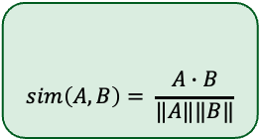
Isolating users cohorts
Group A
3/5 unreliable
20 comments
24months
Group US:
Unreliable sharers
3,998 users
Matching algorithm:
Match similar users from A and B based on similar posting behaviour, including:
Activity time
Number of posts, submissions and subreddits
Compute user embedding:
[user community frequency] x [community embedding]
$$sim\left(A,B\right)= \frac{A∙B}{‖A‖‖B‖}$$
Cosine similarity:
Group B
5 reliable
20 comments
24months
Group RS:
Reliable sharers
3,469 users
Notes:
Can we find these characteristics in communities that are likely to engage with disinformation in a real world scenario?
Isolating user cohorts:
Misinformation Shares: 3/5 misinformation submission, 20 comments in 24 months
Trustworthy Shares:

Slide 12
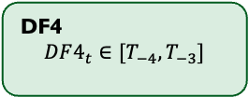
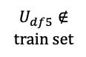
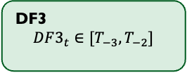
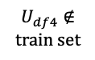
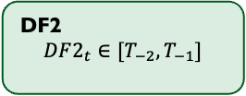
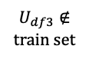
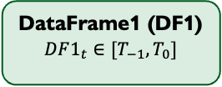
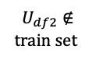

Preprocessing and feature engineering
DataFrame1 (DF1)
$$DF1_{t}∈[T_{−1},T_{0}]$$
Train Set
70% DF1
Test Set
30% DF1
Remove comment to news submission
Split users' activities in 12-month period:
US_{t0} : first unreliable submission
RS_{t0} : T₀ of similar matched MS
DF2
$$DF2_{t}∈[T_{−2},T_{−1}]$$
$U_{df2}∉train set$
yes
T2
Test Set
DF3
$$DF3_{t}∈[T_{−3},T_{−2}]$$
$U_{df3}∉train set$
yes
T3
Test Set
Compute LIWC features for each time-period dataset:
Including all LIWC dimensions
DF4
$$DF4_{t}∈[T_{−4},T_{−3}]$$
T4
Test Set
$U_{df4}∉train set$
yes
DF5
$$DF5_{t}∈[T_{−5},T_{−4}]$$
$U_{df5}∉train set$
yes
T5
Test Set
Notes:
Can we find these characteristics in communities that are likely to engage with disinformation in a real world scenario?

Slide 13
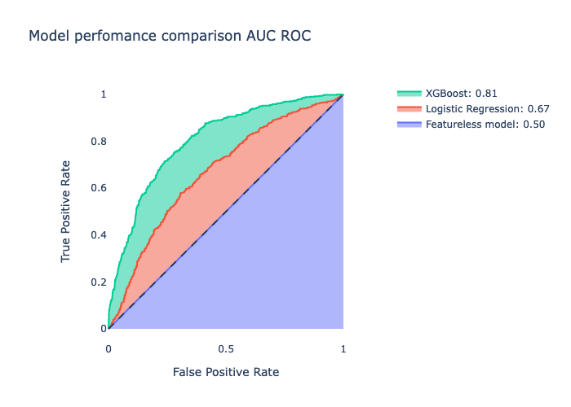
Modelling
XGBoost outperforms featureless and logistic regression in terms of AUC ROC
Featureless: predicts majority class
Logistic Regression: plain-vanilla logistic regression
XGboost: untuned XGBoost model
Accuracy:
Featureless: 0.56
Logistic Regression: 0.56
Boost: 0.74

Slide 14
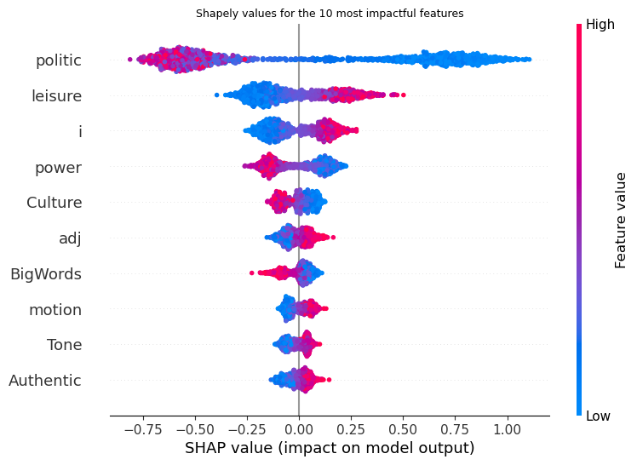
RQ1: Which psycholinguistic characteristics are predictors of users’ probability of sharing (un)trustworthy news sources?
The sign of the value will indicate the direction of the contribution:
Positive sign ➔ decreased probability of sharing misinformation;
Negative sign ➔ increased probability of sharing misinformation.
Notes:
Shapley Values: which LIWC features have the highest impact at predicting users’ likelihood to share misinformation?
Politic: political words
Leisure: game, fun, party
i: first person singular
power: own, order, allow, power
Culture: technology, ethnicity and politics
Adj: use of adjectives
BigWords: frequency of 7+ letter words
Motion: movement
Tone: Degree of emotional tone
Authentic: honesty, geuiniess

Slide 15
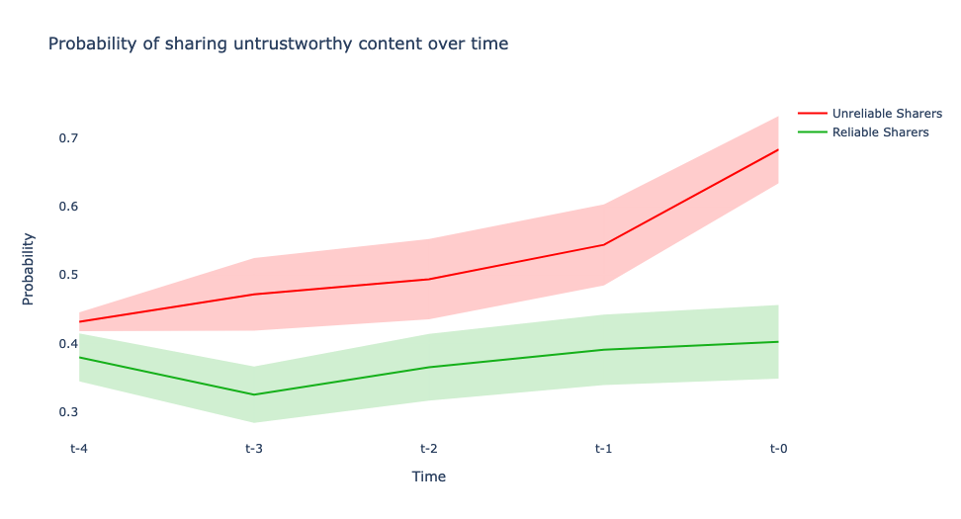
RQ2: How does variation of psycholinguistic characteristic predict future sharing behaviour of (un)trustworthy news sources?
Unreliable news source sharing probability over time:
UR➔ probability increases as time approaches user’s first unreliable submission;
RS➔ probability remains low as users in this group never shared an unreliable news source.
The model can be use as an early warning detection system of users who will share unreliable news source in the future

Slide 16
Discussion

Slide 17

Contributions & Next Steps
Interaction with untrustworthy news sources
Temporal dimension of news diffusion
Human factor characteristics as a predictor of future untrustworthy news diffusion
Role of the individual and human factor characteristics of untrustworthy news diffusion
Psycholinguistics (next steps: transformers embeddings, network features, social, behavioral features) retrieved from a real-world dataset (i.e., Reddit)
Notes:
Underlying cognitive drivers (i.e., political identity, human bias) predominantly studied in isolated lab settings
Dynamics of news diffusion unclear when looking at time-agnostic or cross-sectional data

Slide 18
References [double check]
Baumgartner, J., Zannettou, S., Squire, M., & Blackburn, J. (2020). The Pushshift Telegram Dataset. Proceedings of the International AAAI Conference on Web and Social Media.
Mu Y, Aletras N. Identifying Twitter users who repost unreliable news sources with linguistic information. PeerJ Computer Science (2020)
Shrestha, A., Spezzano, F. Characterizing and predicting fake news spreaders in social networks. Int J Data Sci Anal 13 (2022)
Shrestha, A., Spezzano, F.: Online misinformation: from the deceiver to the victim. In: ASONAM ’19: International Conference on Advances in Social Networks Analysis and Mining,(2019)

Slide 19
Thank you
Pietro Alessandro Aluffi
Pietro.aluffi@unisg.ch

Slide 20
Backup

Slide 21
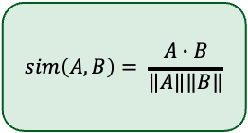
Isolating users cohorts
Group A
3/5 unreliable
20 comments
24months
Group US:
Unreliable sharers
3,998 users
For each user A find a user B such that
first_submission_{A} = first_submission_{B} [year,month]
n_comments_lowtrust_{B} < 10
0.75 < n_comments_{A}/n_comments_{B} < 1.50
0.75 < n_submissions_{A}/n_submissions_{B} < 1.50
last_submission_{A} - first_submission_{A} = last_submission_{B} - first_submission_{B} ± 366 days
0.50 < total_karma_{A}/total_karma_{B} < 2.00
0.50 < n_subreddits_{A}/n_subreddits_{B} < 2.00
Compute user embedding:
[user community frequency] x [community embedding]
$$sim\left(A,B\right)= \frac{A∙B}{‖A‖‖B‖}$$
Group B
5 reliable
20 comments
24months
Group RS:
Reliable sharers
3,469 users
Notes:
Can we find these characteristics in communities that are likely to engage with disinformation in a real world scenario?
Isolating user cohorts:
Misinformation Shares: 3/5 misinformation submission, 20 comments in 24 months
Trustworthy Shares:

